Slide 1
Module 3 Project Planning & Scheduling

Slide 2
Points to be Covered…
Work Breakdown Structure (WBS)
Linear Responsibility Chart
Interface Coordination
Concurrent Engineering
Project Cost Estimation and Budgeting
Top down and Bottom up Budgeting
Networking and Scheduling Techniques
PERT
CPM
GANTT Chart
Introduction to Project Management Information System (PMIS)

Slide 3
1. Work Breakdown Structure
Work Breakdown Structure is a hierarchical tree structure that outlines project and breaks it down into a smaller and more manageable units.
Characteristics
Definable
Manageable
Estimated
Independent
Integration
Measurable
Adaptable
Rules
The 100% Rule
Mutually Exclusive
Focus on Outcomes
The 8/80 Rule

Slide 4
Work Breakdown Structure
100 % rule : the sum of the work at the “child” level must equal 100% of the work represented by the “parent”
“8 – 80” rule - the lowest level of work should be not less than 8 hours and not more than 80 hours.

Slide 5
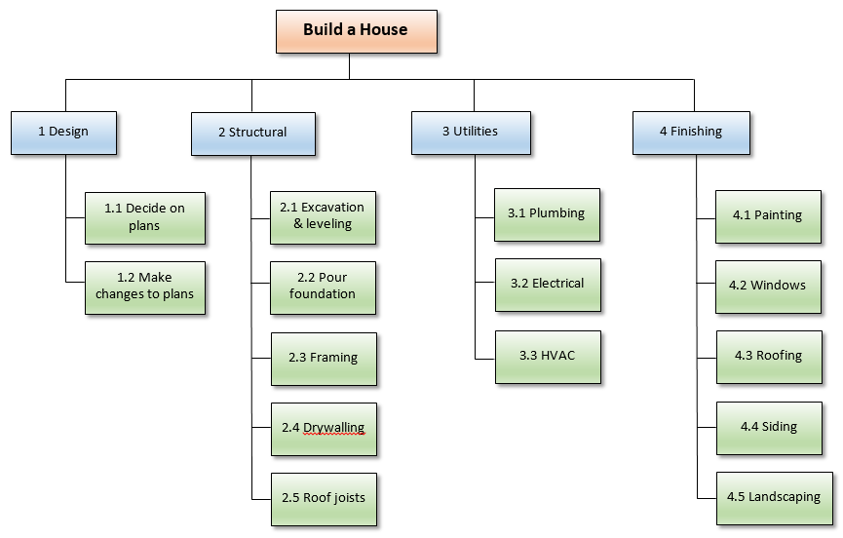

Slide 6
1. Work Breakdown Structure
Different Forms of WBS
Phase-based Structure
Deliverable-based Structure
Responsibility-based Structure
Resource Breakdown Structure
Process to create WBS
Step 1: List high-level deliverables
Step 2: Think about tasks
Step 3: Prepare Minute Details
Step 4: Format and Estimate

Slide 7
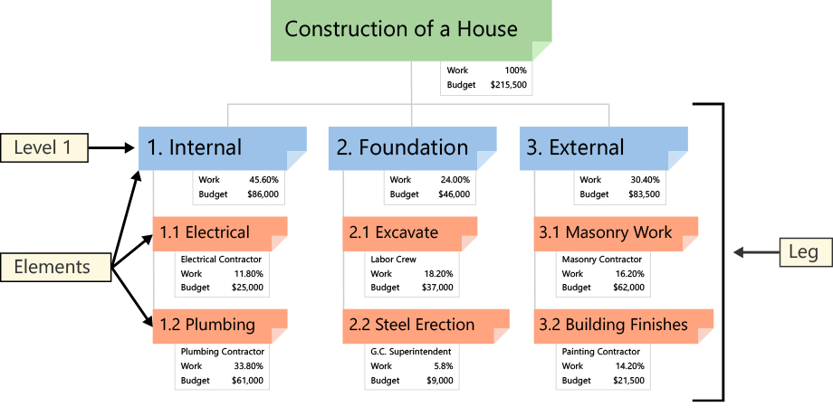
Deliverable based WBS

Slide 8
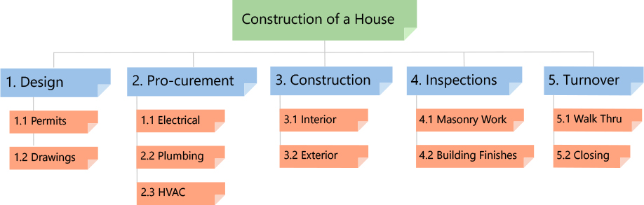
Phase based WBS

Slide 9
Responsibility based WBS
Home Construction
Architect
Civil Engineer
Carpenter
Contractor/Labourer
Electrician
Plumber
Painter

Slide 10
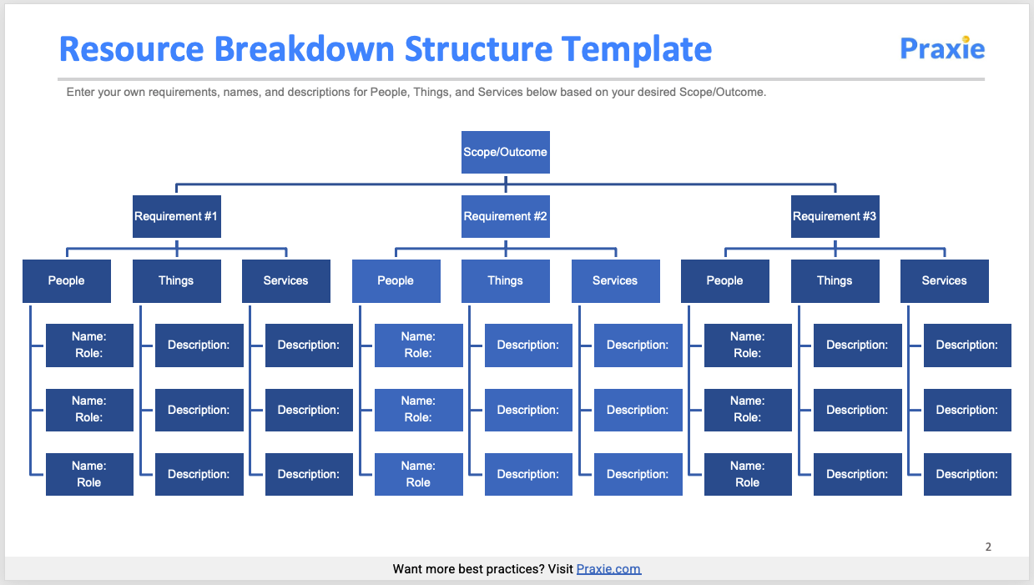
Resource based WBS

Slide 11
1. Work Breakdown Structure…
1. Phase-based work breakdown structure
The first level of a phase-based work breakdown structure will be elements that are typical phases of a project.
The second phase will usually be elements that are distinctive deliverables in each of the phases highlighted.
The lower level of both phase-based and deliverable-based work breakdown structures are elements that are deliverables.
For a phase-based work breakdown structure, work associated with different elements will be divided into work unique to the element in the first level of your work breakdown structure.
2. Deliverable-based work breakdown structure
A work breakdown structure based on the deliverables identifies connections between the project’s deliverables and the scope.

Slide 12
1. Work Breakdown Structure…
3. Responsibility-based work breakdown structure
The responsibility-based work breakdown structure defines the project’s elements by the organizational units that will work on the project.
The first level of the structure in a responsibility-based work breakdown structure will be the organization units, the rest of the levels will often follow the same format as the other two work breakdown structures.
4. Resource Breakdown Structure
Resource Breakdown Structure (RBS) is a project management tool that provides a hierarchical decomposition of resources, either structured by resource category, types or by IT/business function that has resource needs.

Slide 13
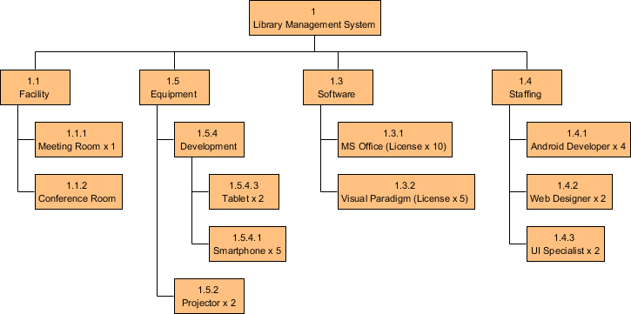
Example of Resource Breakdown Structure

Slide 14
2. Linear Responsibility Chart
Linear Responsibility Chart is the chart of responsibility which defines the project participants and shows authority and responsibility relationships among them.
It is also called as Linear Chart, Matrix Responsibility Chart (MRC), Responsibility Interface Matrix (RIM), Responsibility and Accountability (RAM).

Slide 15
3. Interface Coordination
Interface Coordination is a process that facilitates agreements with other stakeholders regarding roles and responsibilities, timing for providing interface information and identification of critical interfaces early in the project through a structured process.
Interface is defined as a point of connect between entities working on a common project.
Interfaces are
Physical
Functional
Contractual
Organizational
Knowledge
Resource

Slide 16
3. Interface Coordination…
Objectives
Identify the appropriate personnel who will be responsible for each interface request and for the resolution of interface request.
Provide a system that will facilitate the identification of interfaces and address the specific interface request requirements.
Establish a procedure that promotes efficient management of interface issues from initiation to close out.
Define methods for communication and coordination of interface requests between various parties.
Facilitate clear and frequent communications amongst parties.
Facilitate the agreement of a schedule for interface request resolution and close-out.
Define a means for the control, expediting, and reporting of progress on the transfer of interface requests.
Define processes of assurance that interface requests are effectively identified and managed.

Slide 17
3. Interface Coordination…
Process
Identification and recording an interface.
Creating an interface agreeing.
Agreeing/ Resolving Conflict.
Monitoring the Status.
Reporting the Status.
Closing the Interface Agreement.

Slide 18
3. Interface Coordination…
Roles and Responsibility of Interface Coordinators
Participants in interface meetings with involved parties are required to manage interfaces.
Review outgoing interface requests and serve as interface requests.
Ensure resolution of inbound interface requests.
Actively monitor interface request register to expediting requests and open/update/close requests on behalf of their team.
Provide collaborate interface resolution support.
Serve as PMT liaison between contractor and operating plant point of contract. Project liaisons communicate effectively between multiple team members and stakeholders. The job will require persuasiveness, approachability, likeability, adaptability, and skills in project management.
Inform Interface Manager of potential impacts due to unsatisfactory resolution response.

Slide 19
4. Concurrent Engineering
Concurrent Engineering is a method of designing and developing products, in which the different stages run simultaneously.
It is a systematic approach to integrated product development that emphasizes the response to customer expectations.
Methods to implement Concurrent Engineering
Project Methods
Problem Solving Methods

Slide 20
4. Concurrent Engineering…
Advantages
Encourage multi-disciplinary collaboration.
Reduces product cycle time.
Reduces cost.
Increase quality by supporting the entire project cycle – enhanced quality.
Increases productivity by stopping the mistakes in their trends.
Gives the competitive edge advantage.
Disadvantages
Complex to manage.
Relies on everyone working together hence communication is critical.
Room for mistakes are small as it impacts all the electrical, mechanical, software departments or disciplines.

Slide 21
5. Project Cost Estimation and Budgeting
Project Cost Estimation is the process of determining the total expenditure of the project.
Project Cost Management
Plan Cost Management
Estimate Costs
Determine Budget
Control Costs

Slide 22
5. Project Cost Estimation and Budgeting…
Plan Cost Management
Plan Cost Management is the process that establishes the policies, procedures, and documentation for planning, managing, expending, and controlling project costs.
Inputs
Project management plan
Project charter
Enterprise environmental factors
Organizational process assets
Tools and Techniques
Expert judgment
Analytical techniques
Meetings
Outputs
Cost management plan

Slide 23
5. Project Cost Estimation and Budgeting…
Estimate Cost
Estimate Costs is the process of developing an approximation of the monetary resources needed to complete project activities.
Inputs
Cost management plan
Human resource management plan
Scope baseline
Project schedule
Risk register
Enterprise environmental factors
Organizational process assets
Tools and Techniques
Expert judgment
Analogous estimating
Parametric estimating
Bottom-up estimating
Three-point estimating
Reserve analysis
Cost of quality
Project management software
Vendor bid analysis
Group decision-making techniques
Outputs
Activity cost estimates
Basis of estimates
Project documents updates

Slide 24
Tools and technique for cost estimation
Expert Judgement
While estimating the project cost, the first step is to take the comments from the experts. The experts are the people who have prior knowledge on similar kind of projects. So they can suggest valuable insight based on their experience. You can also take their advice on various tools and techniques that can be used to estimate similar kind of project.
Analogous Estimation
Normally, at the early stages of your project, you do not have much detail, so taking into account of similar projects previously completed by your organization, the cost of the project can be estimated. Analogous estimation technique uses the parameters such as scope, budget, duration, size, weight and complexity of previous projects having similar nature of works. It measures the current project on that basis and does the estimation.

Slide 25
Tools and technique for cost estimation
Analogous Estimation Continues
The technique is less costly and less time-consuming. But the accuracy of this estimation is lower than the other estimation techniques as it is purely based on historical data. It can be applied to the whole project or some part of the project in combination with other techniques.
For example, if the budget of a particular activity in the previous project has X amount, and by measuring the same activity in your current project looks identical, then the same X amount can be applied to that.
Parametric Estimation
This technique uses an algorithm to calculate the cost of the activity considering the historical data and other project variables. A statistical relationship needs to be evaluated between the historical data and other variables. This technique can be used for the complete project or for some of the activities in conjunction with other estimation techniques.

Slide 26
Tools and technique for cost estimation
Parametric estimation continues
For example, in an industrial project, one of the activities is to make 10 valves in the first phase. So as part of historical data gathering, you got the information that construction of each valve requires $150.
Based on that information you can calculate as:
Total cost of making 10 valves = cost per valves * no. of valves
Total cost = 150*10 = 1500
Bottom-Up Estimation
Bottom-up estimation technique starts with the estimation from the lower level i.e. the work package level created as per WBS and then rolled up to higher-level. The accuracy of this estimation technique is high as you are doing the estimation from granular level

Slide 27
Tools and technique for cost estimation
Bottom-Up Estimation
Bottom-up estimation technique starts with the estimation from the lower level i.e. the work package level created as per WBS and then rolled up to higher-level. The accuracy of this estimation technique is high as you are doing the estimation from granular level
Three-Point Estimation
To deal with uncertainties and risk, you need to take the help of three-point estimation which is also referred as PERT- Program Evaluation and Review Technique.
The Program Evaluation and Review Technique use three types of estimations:
M – Most Likely: The realistic or ideal situation, all the required resources will be assigned and can achieve the expected productivity
O – Optimistic: Estimation based on best case scenario
P – Pessimistic: Estimation based on worst case scenario
Based on the above assumptions, the expected duration can be calculated using two basic formulas.
Triangular Distribution – (O+M+P)/3
Beta distribution – (O+4M+P)/6

Slide 28
Tools and technique for cost estimation
Reserve Analysis
To deal with uncertainty, you need to allocate some funds called as the contingency reserve. That is the part of the cost baseline to mitigate the identified and accepted risks. Also for unknown risks, an amount needs to be estimated which is called management reserve. This is not included in the cost baseline but part of the overall project budget. It is important to keep the reserve budget to deal with uncertain events. The contingency reserve is under the project manager authority, while to use the management reserve the project manager need to take approval from the sponsors.
Cost of Quality
Basically, two types of costs are there to ensure the quality, one is called the cost of conformance which is the budget required for prevention and appraisals, and another one is cost of non-conformance that may be used up due to internal and external failures. Cost of quality means estimating the cost of both conformance and non-conformance expenses.

Slide 29
Tools and technique for cost estimation
Project Management Software
There are some tools which can be used to perform the project cost estimation, such as cost estimating software application, spreadsheets, simulation and statistical tools.
Vendor Analysis
This is another technique to estimate the cost by comparing the various bids proposed by the vendors. There may be differences in their bids but you can get an idea considering the average bid values.

Slide 30
Tools and technique for cost estimation
Group Decision Making Techniques
This technique emphasizes the involvement of a group of people who are going to perform the technical work. By involving those you will gain more details on the work and thus helpful to estimate more accurately. Also, it develops a commitment from the people who are involved in the discussion to complete the work as estimated.
Depending upon the nature of your project, either you can apply these techniques together or in combinations of few techniques to estimate the project cost. Also, keep in mind that the estimations are never drawn to an exact figure; it is always in the probable ranges. In the initial phases, the preliminary estimate ranges between -15% to +50%, while the rough order of magnitude estimates in between -25% to +75%. And the budget estimate falls in -10% to +25% ranges.

Slide 31
5. Project Cost Estimation and Budgeting…
Determine Budget
Determine Budget is the process of aggregating the estimated costs of individual activities or work packages to establish an authorized cost baseline.
Inputs
Cost management plan
Scope baseline
Activity cost estimates
Basis of estimates
Project schedule
Resource calendars
Risk register
Agreements
Organizational process assets
Tools and Techniques
Cost aggregation
Reserve analysis
Expert judgment
Historical relationships
Funding limit reconciliation
Outputs
Cost baseline
Project funding requirements
Project documents updates

Slide 32
5. Project Cost Estimation and Budgeting…
Control Cost
Control Costs is the process of monitoring the status of the project to update the project costs and managing changes to the cost baseline.
Inputs
Project management plan
Project funding requirements
Work performance data
Organizational process assets
Tools and Techniques
Earned value management
Forecasting
To-complete performance index (TCPI)
Performance reviews
Project management software
Reserve analysis
Outputs
Work performance information
Cost forecasts
Change requests
Project management plan updates
Project documents updates
Organizational process assets updates

Slide 33
6. Top Down and Bottom Up Budgeting
Top Down estimating is a project estimating technique in which the overall project is estimated first and then individual task are apportioned from it.
Bottom Up estimating is a project estimating technique in which the individual task are estimated first and rolled up into overall project estimate.

Slide 34
7. Networking and Scheduling Techniques
Network Planning is a technique used to plan, schedule and control the interrelated activities of the project.
Network Diagram is a graphical representation of all the tasks, responsibilities and workflow for a project.
Types of Network Diagrams
Arrow Diagram Method
Precedence Diagram Method

Slide 35
7. Networking and Scheduling Techniques…
Concepts of Network Analysis
Activity
Predecessor Activity
Successor Activity
Concurrent Activity
Dummy Activity
Event
Merge Event
Burst Event
Merge and Burst Event
Techniques of Network Analysis
Critical Path Method (CPM)
Programme Evaluation and Review Technique (PERT)

Slide 36
8. PERT
PERT is a management technique used with responsibility accounting and to attain well defined objectives.
It is designed for scheduling complex interrelated tasks of the projects.
PERT System of Three Time Estimate
Optimistic Time
Most likely Time (tm)
Pessimistic Time (tp)

Slide 37
8. PERT…
PERT Algorithm
Develop a list of activities that made up the project including immediate predecessors.
For each activity, a rough PERT network is drawn on the basis of which activity precedes, which activity follows which one, which activity are concurrent with which one.
The network is sketched to conform to rules and conventions.
Events are numbered in ascending order from left to right.
Time estimates (Optimistic Estimate, Most Likely Estimate, Pessimistic Estimate)for each activity are obtained.
Then upon the assumption of beta distribution for the activity duration, the expected time te for each activity is computed using te = 1(1+4m+b)/6.

Slide 38
8. PERT…
PERT Algorithm…(continued)
Using the expected activity time estimates, determine the earliest start time and the earliest finish time for each activity, the earliest finish time for the complete project corresponds to the earliest finish time for the last activity.
After determining the latest start time and the latest finish time for each activity, compute the float associated with each activity, the critical path activities are the activities with zero float. Determine now the critical path through the given network.
Using the values for b and a, which were determined in step 5. calculate the variance (σ²) of each activities time estimated by σ² = [1(b-a)/6] ².
Use the variability in the activity times to estimate the variability of the project completion date, then using this estimate compute the probability of meeting a specified completion date by using the standard normal equation
Z = Due date – Expected date of completion
√ Project Variance
where Z = no of standard deviations the due date or target date lies from the mean or expected date

Slide 39
9. CPM
CPM method is developed by E. I. du Pont de Nemours Company (USA) in 1958.
It is used to schedule and control the project.
It is used to estimate the total project duration and to assign starting and finishing times to all activities involved in the project.
CPM Systems
Activity-On-Arrow (AOA) Network
Activity-On-Node (AON) Network

Slide 40
9. CPM…
Steps
Break down the project into various activities systematically. Label all activities. Arrange all the activities in logical sequence. Construct the network diagram.
Number all the nodes (events) and activities. Find the time for each activity considering it to be deterministic. Indicate the activity times on the arrow diagram.
Calculate earliest start time, earliest finish time, latest start time and latest finish time. Tabulate activity normal times, earliest times and latest times.
Determine the total float for each activity by taking difference between the earliest time and latest time for each node.
Identify the critical activities and connect them with the beginning node and the ending node in the network diagram by double line arrow. This gives the critical path.
Calculates the total project duration.
Reduce the total project duration, crash the critical activities of the network.
Optimize the cost.
Update the network and smooth the network resource.

Slide 41
10. GANTT Chart
Gantt bar Chart is a horizontal bar chart that visually represents a project plan over time.
It shows the status of each task and who’s responsible for each task in the project.
Key Parts of Gantt Chart
Task List
Timeline
Dateline
Bars
Milestones
Dependencies
Progress
Resource assigned

Slide 42
10. GANTT Chart…
22/10 29/10 5/11 12/11 19/11 26/11 3/12 10/12 17/12 24/12 31/12
Preliminary Investigation
Write Report
Interviews
Training
Evaluation
Final Report
Report Date
Fig: Gantt Chart of Project Schedule

Slide 43
10. GANTT Chart…
Functions of Gantt Chart
Plan, schedule, manage and monitor the tasks involved in the projects.
Define the tasks that require completion.
The chart is displayed as a horizontal bar chart.
Horizontal bars of different length represent the project timeline.
This includes task sequence, task duration, task start date and task end dates.

Slide 44
10. GANTT Chart…
Benefits of Gantt Chart
It identifies all the task, task which are executing in parallel and dependent tasks.
It organizes high level tasks and resource allocation.
It detects potential bottlenecks and identify tasks that may have been excluded from the project timeline.
The bars represents which tasks are completed.
It depicts the task slack time

Slide 45
11. Introduction to Project Management Information System (PMIS)
PMIS is a computer based information system that efficiently stores and organized information needed to run a project.
Project Management Book of Knowledge (PMBOK) is an information system consisting of the tools and techniques used to gather, integrate and disseminate the outputs of project management processes.
Objective:
To reduce project duration
Minimize the cost of crashing

Slide 46
11. Introduction to Project Management Information System (PMIS)…
Tools used by PMIS
Schedule and Planning
Resource Management
Budget
Control and Performance
Reporting and Communication
Integration and Ease of Use

Slide 47
11. Introduction to Project Management Information System (PMIS)…
Functions
During initiation phase, Project Manager uses PMIS to prepare preliminary budget including cost estimate and resource.
It schedules the project.
It define the scope of work, assists with preparing the bid and can be used when presenting the data to decision-makers.
It supports cost management planning including WBS analysis and integration of control processes.
It proves beneficial to the Project Manager when resource planning in terms of availability and level.
It establishes a baseline for project scope, schedule and cost.
Once the project has been executed, PMIS starts collecting, organizing and storing data as it comes in from the project team, which is then compared to the baseline projections.
It uses cost and schedule forecasts to help if changes are required mid-project.
It supports materials management, cost collect, performance measurement and reporting.
During closing, it review requirements to make sure that project has met all its goals and objectives.
It organizes all the collected information for performance review, productivity analysis, final reports and then keeps an archive with the historical data for future projects.

Slide 48
Thank you

